Slide 1
Working with OPP Code Files

Slide 2
Agenda
General Information
Creating New Code Files
Populating a Code File
Assigning Code files to an OPP Project
Code File Maintenance

Slide 3
General Information
Coding typically describes a hierarchy of project information, such as work breakdown structures or organizational structures. Codes based on breakdown structures are applied to the activities in OPP projects. Coding allows project data to be summarized, or filtered, to appropriate levels for specific reporting requirements.
Code files can be specific to a project or shared by several projects. Changes to a code file affect all the projects to which the file is assigned.
Code types are Punctuated Significant and Fixed Format Significant. The periods in a punctuated significant code file distinguish between hierarchical levels in the structure. Fixed format codes rely on the length of the code to represent the structure level. (see next slide for illustration of the two types)

Slide 4
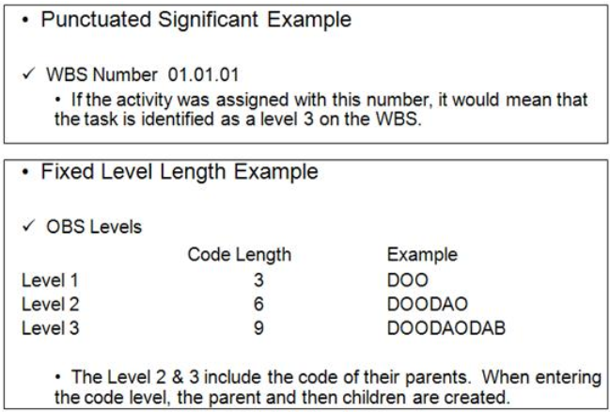
General Information Cont.

Slide 5
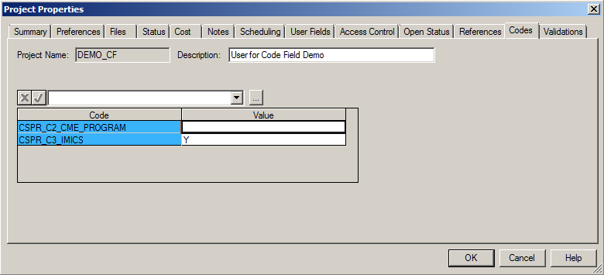
General Information Cont.
There are three categories of code files:
Standard Code Files (assigned in code positions C01 through C50)
Program Specific Code Files (assigned in code positions C51 through C90)
Project Level Code Files (CSPR_C2_CME_PROGRAM, and CSPR_C3_IMICS). The project level codes are created by SYSADMIN and are automatically attached to the projects. These codes are located in the Project Properties/Codes tab.

Slide 6
General Information Cont.
Standard code file usage has been identified in order to maintain commonality across the enterprise. Reference the Data Dictionary listing located in the OPP Reference section on the CSPR Website under Help > Documentation:
http://evtools.web.boeing.com/doc.cfm.
Code files must adhere to a standard naming convention of Program Name_Contract Name_CXX (where XX is the code designator). An example of a program specific code file would be F18M_AESA_C54. Code files common to all users are created and maintained by SYSADMIN and those code files follow the naming convention of CSPR_CXX. An example of a CSPR code file would be CSPR_C35. Note: Do not enter spaces in the file name.

Slide 7
Creating New Code Files
Creating New
Creating New as Copy of Existing

Slide 8
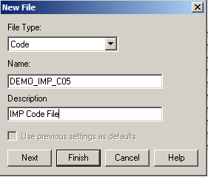
Creating a New Code File
From the Open Plan Explorer, select File>New>Code File
The New File box opens with File Type ‘Code’ already selected
Type in the Name as desired based on the CSPR 3 naming convention: Program Code_Contract Code_CXX
Type in the Code Description
Click Next

Slide 9
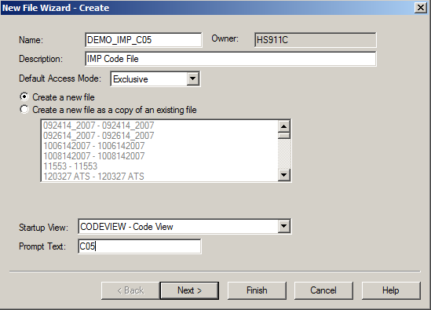
Creating a New Code File
The New File Wizard – Create box opens
Select the Default Access Mode for the code file: Exclusive, Shared, or Read only
Select the Create a new file option
Select the Startup View
Provide the Prompt Text
Click Next

Slide 10
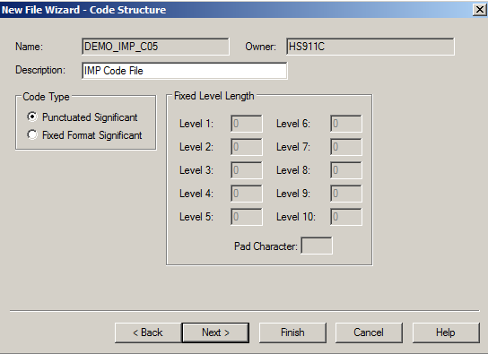
Creating a New Code File
The New File Wizard – Code Structure box opens
Select the Code Type – Punctuated Significant, or Fixed Format Significant
Click Next

Slide 11
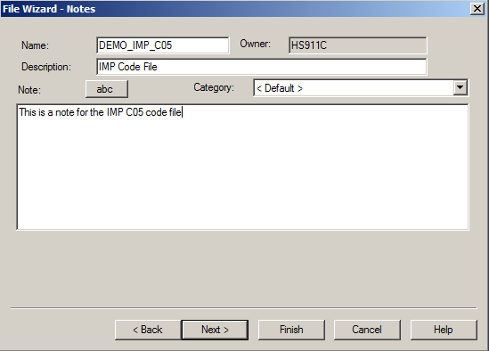
Creating a New Code File
The File Wizard – Notes box opens
Type any desired notes here
Click Next

Slide 12
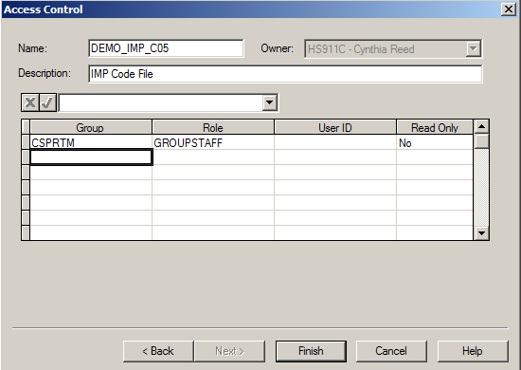
Creating a New Code File
The Access Control box opens
Assign the appropriate access for the code file
Click Finish

Slide 13
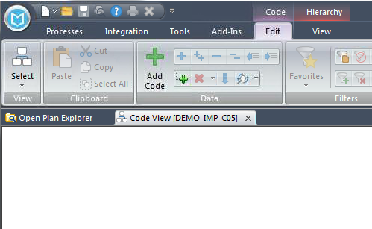
Creating a New Code File
The code file has been created and will open to an empty view
Click File>Save to save the newly created code file

Slide 14
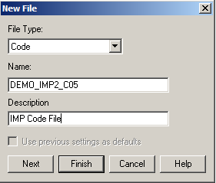
Creating New by Copying an Existing Code
From the Open Plan Explorer, select File>New>Code File
The New File box opens with File Type ‘Code’ already selected
Type in the Name as desired based on the CSPR 3 naming convention: Program Code_Contract Code_CXX
Type in the Code Description
Click Next

Slide 15
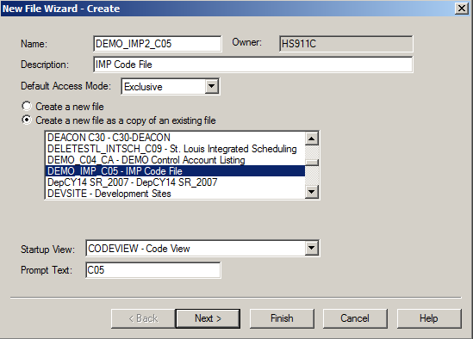
Creating New by Copying an Existing Code
The New File Wizard – Create box opens
Select the Default Access Mode for the code file: Exclusive, Shared, or Read only
Select the Create a new file as a copy of an existing file option & pick the code file to copy
Select the Startup View
Provide the Prompt Text
Click Next

Slide 16
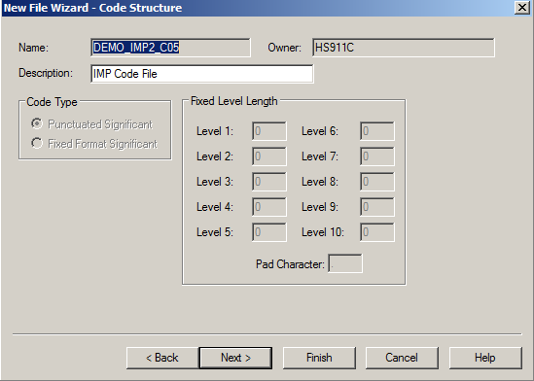
Creating New by Copying an Existing Code
The New File Wizard – Code Structure box opens
Update the code file description if desired (all other options are greyed out)
Click Next

Slide 17
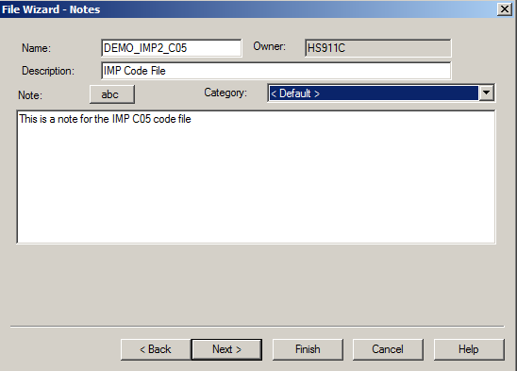
Creating New by Copying an Existing Code
The File Wizard – Notes box opens
Type any desired notes here
Click Next

Slide 18
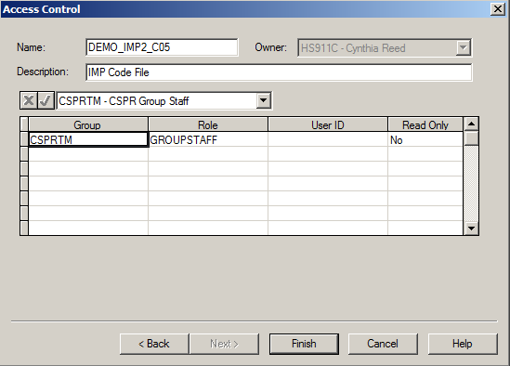
Creating New by Copying an Existing Code
The Access Control box opens
Assign the appropriate access for the code file
Click Finish

Slide 19
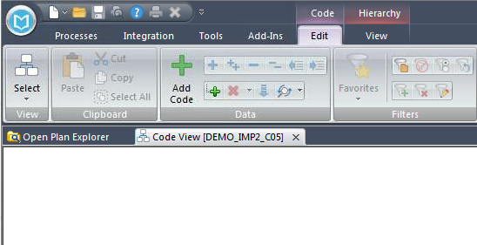
Creating New by Copying an Existing Code
The code file has been created and will open to an empty view
Click File>Save to save the newly created code file

Slide 20
Populating a Code File
Manually Populate via the Code Details Box
Manually Populate via a Spreadsheet View
Import from Excel to Populate
Use OPP/Cobra Mapping Tool to Populate

Slide 21
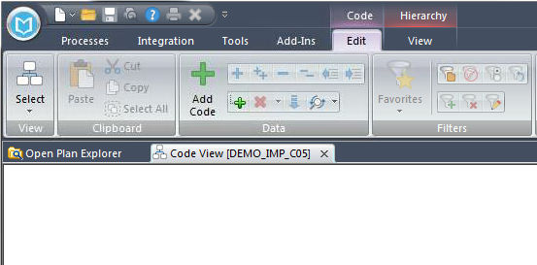
Manually Populate via the Code Details Box
Open the code file in Exclusive mode
The code file will appear as an empty screen
Double click in the blank white area, or right mouse click and select Add Code, or select the Edit ribbon, ‘+’ Add Code

Slide 22
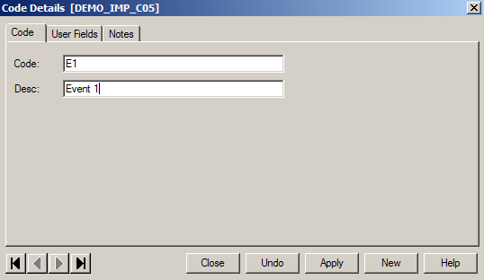
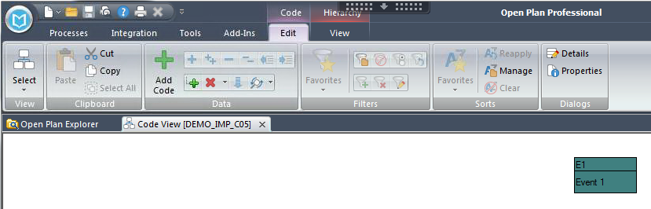
Manually Populate via the Code Details Box
The Code Details box opens
Type in the desired code and description
Click either Close or Apply to add the code to the file
Type in Code & Desc
Resulting Code

Slide 23
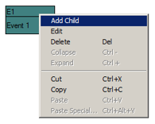
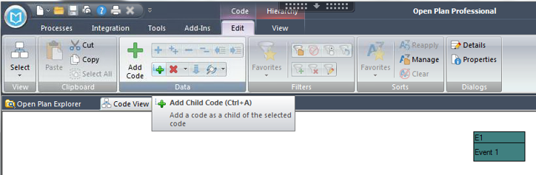
Manually Populate via the Code Details Box
To add a ‘child’ to the existing code, right mouse click on the code and select Add Child or click the ‘+’ Add Child Code icon from the Edit ribbon
Note: The code will automatically populate with the ‘parent’ information, so only the ‘child’ portion of the code will need to be populated
Right clicking
Going through Edit ribbon

Slide 24
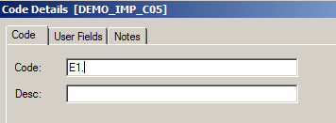
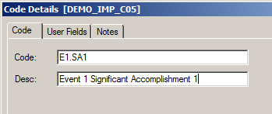
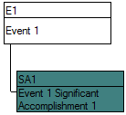
Manually Populate via the Code Details Box
Update Code and Desc. with the child code information
Click either Close or Apply to add the code to the file
The new code will display as:
Default, before adding child info
Child info added
Code ID
Description

Slide 25
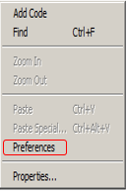
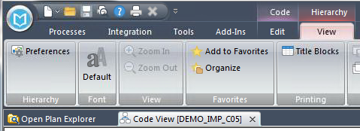
Manually Populate via the Code Details Box
The Code ID will only display the ‘child’ portion of the code, by default.
To display the entire ID, right mouse click in the blank portion of the open code file view and select Preferences, or from the View ribbon, select Preferences
View ribbon menu
Right click menu

Slide 26
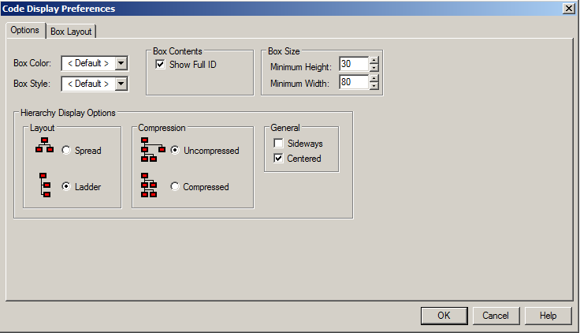
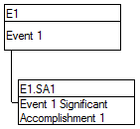
Manually Populate via the Code Details Box
The Code Display Preferences box opens
Check the Box Contents option to Show Full ID
Click OK
Note: other display options may also be selected in the Code Display Preferences box, customize as needed
Now we see the full code ID

Slide 27
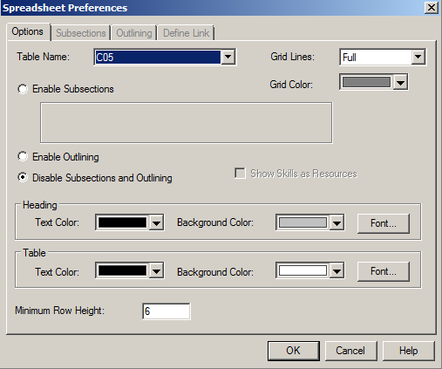
Manually Populate via a Spreadsheet View
Codes can be manually entered into a spreadsheet view once the code file is attached to the OPP project and the code file is open in exclusive mode.
Open a spreadsheet view
From the View ribbon, click Preferences or right mouse click in the view and select Preferences
The Spreadsheet Preferences box opens
On the Options tab, select the code file from the Table Name drop down list
Click OK

Slide 28
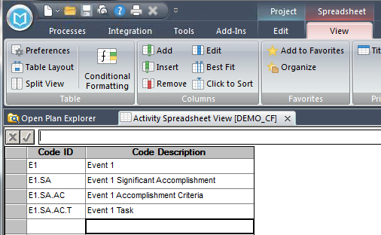
Manually Populate via a Spreadsheet View
Type in the desired codes and code descriptions
Once complete, perform a File>Save to save updates to the code file.

Slide 29
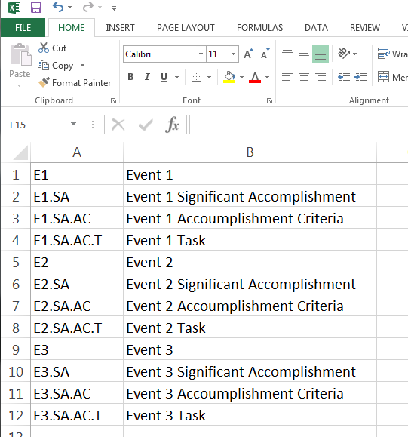
Importing from Excel
Code Files can be quickly populated by importing the code data from an Excel file.
The Excel file should contain the code in column A, and the code description in column B. There should be no headings in the file, and no commas in the code or code description

Slide 30
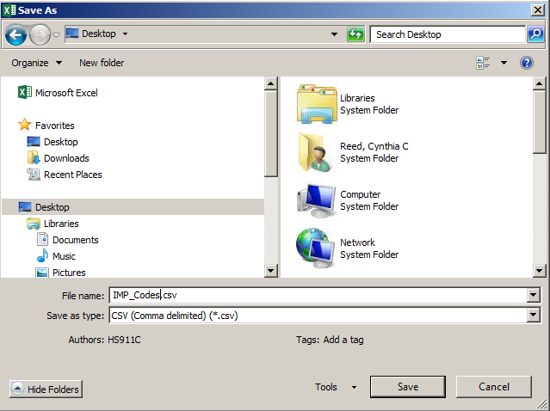
Importing from Excel
Perform a File>Save As (change type to .csv), click Save

Slide 31
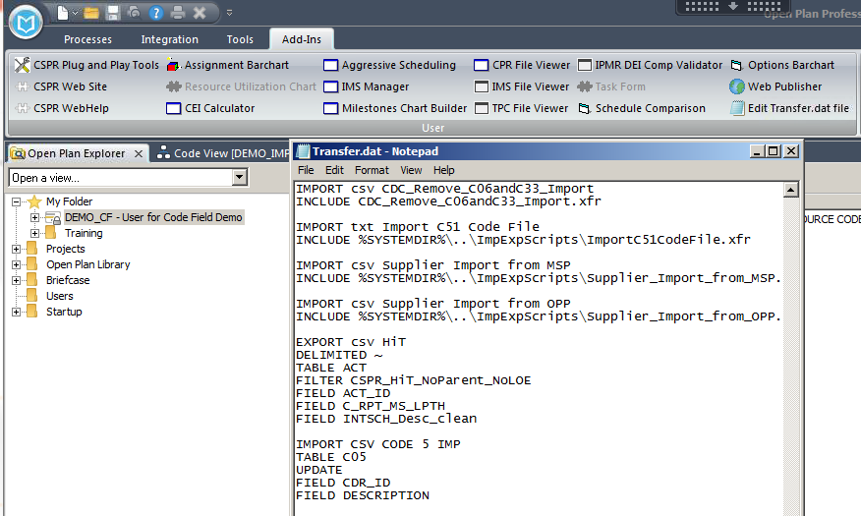
Importing from Excel
Update the User.dat file located in your CSPR user folder with a script to import the contents of the Excel file. This script will be available the next time you log into OPP. The script can also be copied and saved into the Transfer.dat file, access from Add-ins ribbon, then Edit Transfer.dat file for immediate use.

Slide 32
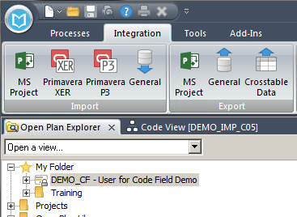
Importing from Excel
To import the contents of the Excel File, first open the code file in exclusive mode, then open the OPP project in exclusive mode. With the project highlighted, go to the Integration ribbon, and select General from the Import section

Slide 33
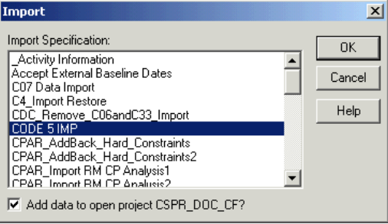
Importing from Excel
The Import box opens.
Highlight the desired Import Specification
Check the box to Add data to open project
Click OK

Slide 34
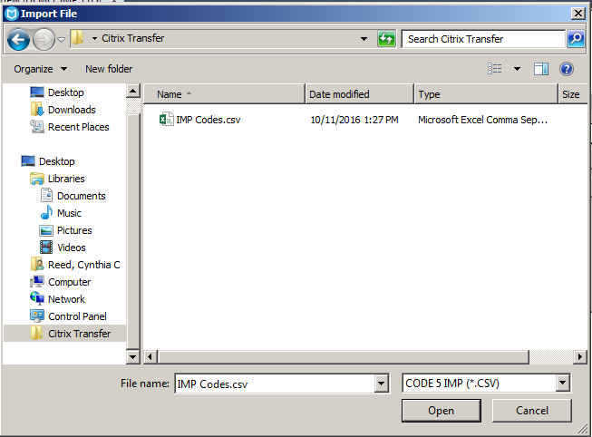
Importing from Excel
The Import File box opens
Browse to locate the .csv file to be imported
Click on (highlight) the file name
Click Open

Slide 35
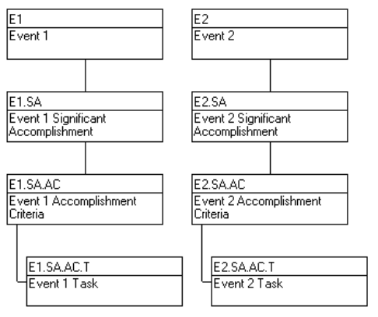
Importing from Excel
The code file will be updated with the codes and descriptions contained in the Excel file.
Save the changes to the code file. (File>Save)
See Also: Advanced Import Export Training Material

Slide 36

Using OPP/Cobra Mapping Tool
The Plug and Play OPP/Cobra Mapping Tool can be used to populate the OPP control account code file with data from the control accounts set up in Cobra and flagged for OPP. Using the OPP/Cobra Mapping tool will eliminate possible data anomalies between the OPP and Cobra control accounts. This tool can be used once the OPP project has been associated with a Cobra program.
To import the control account information from Cobra, first open the code file in exclusive mode, then open the OPP project in exclusive mode.
Click on the Add-ins ribbon, then CSPR Plug and Play Tools, and double click on the OPP/Cobra Mapping tool icon

Slide 37
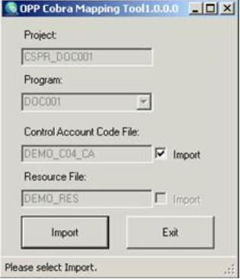
Using OPP/Cobra Mapping Tool
The OPP Cobra Mapping Tool box opens.
Verify the Project box is populated with the correct OPP project
Verify the Program box is populated with the correct Cobra program
Verify the Control Account Code File box is populated with the correct control account file
Check the Control Account Code File Import box (on right)
Select Import

Slide 38
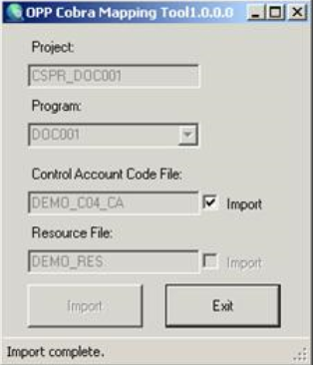
Using OPP/Cobra Mapping Tool
Import complete will display in the status bar at the bottom of the dialog box once the import has finished

Slide 39
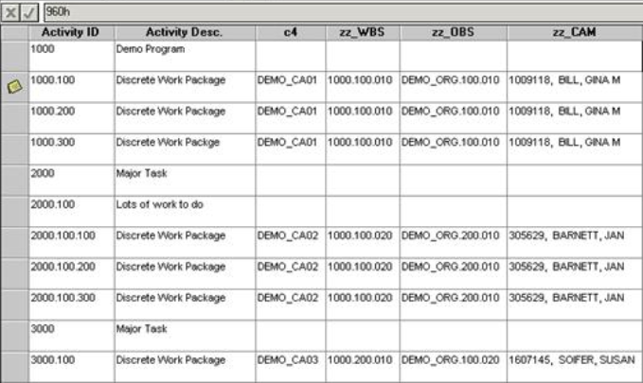
Using OPP/Cobra Mapping Tool
Verify the results of the import
Save (File>Save)the revisions to the control account code file and the OPP project
Note: The OPP control accounts will be updated with the WBS, OBS, and CAM information populated on the control accounts in Cobra. This information will be displayed in the OPP calculated fields zz_WBS, zz_OBS, and zz_CAM.
Note: If new control accounts are added in Cobra, the OPP/Cobra Mapping Tool must be run to update the OPP control account code file. If control accounts are deleted from Cobra and not assigned to any activities in OPP, the control account must be manually deleted from the OPP control account file.

Slide 40
Assigning Code Files to an OPP Project
Assign using Project Properties
Assign using Drag and Drop

Slide 41
Assigning Code File to a Project
Code files must be assigned to the correct code position in order to maintain common code usage across the enterprise. Reference the Data Dictionary listing located in the OPP Reference section on the CSPR Website under Help>Documentation:
http://evtools.web.boeing.com/doc.cfm

Slide 42
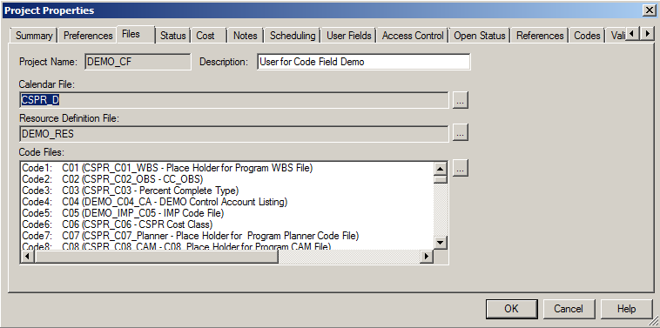
Assigning to Project via Project Properties
Open the OPP project in exclusive mode
From the Processes ribbon, select Properties in the Dialogs section
Select the Files tab inside of the Project Properties window
Click on the Code Files ellipsis to access the Assign Code box

Slide 43
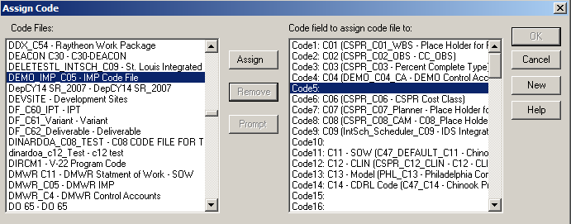
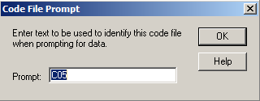
Assigning to Project via Project Properties
The Assign Code box opens
Verify the correct code file is highlighted in the Code Files panel
Highlight the Code position in the Code field to assign code file to panel
Click the Assign button located in the center of the Assign Code box
Verify the Prompt is correct or revise if necessary (box opens once you click Assign), Click OK
Notes:
Note: Recommend always making the prompt start with Cxx then you can add a description if necessary. By using a prompt with the Cxx first, this makes all codes easier to location when trying to add to a view.

Slide 44
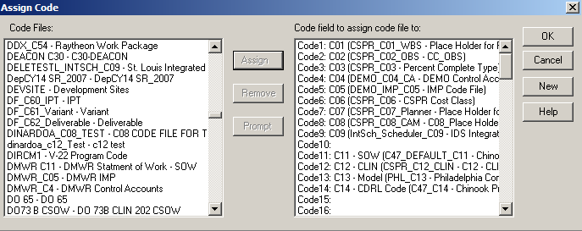
Assigning to Project via Project Properties
The code file is now associated to the OPP project
Click OK
The Project Properties box will be visible
Click OK
Save the OPP project (File>Save)
Note: Code files can be assigned at the master project level and then saved to all subprojects associated with the master project by following the steps below:
Add the new code file(s) to one external subproject and save the project
Open the master project (with all subprojects opened exclusively) – this will add the new code files to the code file structure in the master project
Save the master project – this will “push” down the new code files to all the external subprojects that don’t already have a code file in those positions

Slide 45
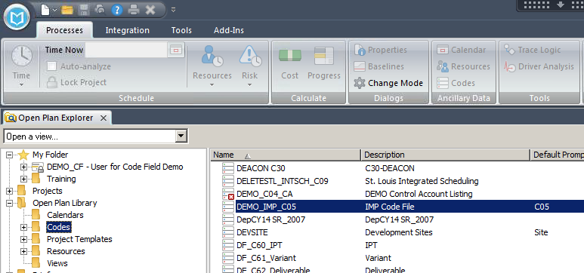
Assigning to Project via Drag and Drop
Open the OPP project in exclusive mode
Highlight the Codes folder in the OPP Library (left pane)
Highlight the code file to be added (right pane)
Drag the highlighted code file from the right and drop it onto the project you have open exclusively (in Open Plan Explorer, on left)

Slide 46
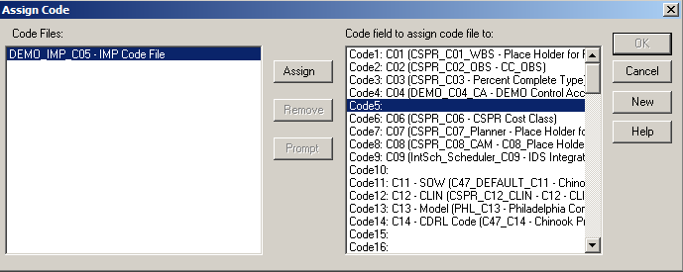
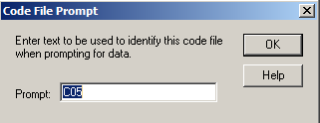
Assigning to Project via Drag and Drop
The Assign Code box opens
Verify the correct code file is highlighted in the Code Files panel
Highlight the Code position in the Code field to assign code file to panel
Click the Assign button located in the center of the Assign Code box
Verify the Prompt is correct or revise if necessary (box opens once you click Assign), Click OK
Notes:
Note: Recommend always making the prompt start with Cxx then you can add a description if necessary. By using a prompt with the Cxx first, this makes all codes easier to location when trying to add to a view.

Slide 47
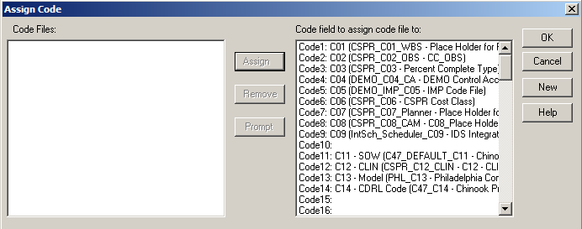
Assigning to Project via Drag and Drop
The code file is now associated to the OPP project
Click OK
Save the OPP project (File>Save)
Note: Code files can be assigned at the master project level and then saved to all subprojects associated with the master project by following the steps below:
Add the new code file(s) to one external subproject and save the project
Open the master project (with all subprojects opened exclusively) – this will add the new code files to the code file structure in the master project
Save the master project – this will “push” down the new code files to all the external subprojects that don’t already have a code file in those positions

Slide 48
Code File Maintenance
Update existing code file
Add New Code Elements
Delete Existing Code Elements
Revise Existing Code Elements
Remove a Code File from an OPP Project
Delete a Code File from the OPP Library
Print the Contents of a Code File

Slide 49
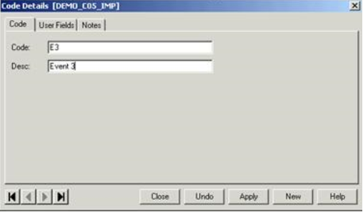
Update – Add New Code Element
Open the code file in exclusive mode
Using the Code View, Double click in the blank white area, or right mouse click and select Add Code, or select the Edit ribbon, ‘+’ Add Code
Enter the desired Code and Description
Click Apply or Close to add the code to the code file
Save the code file (File>Save)

Slide 50
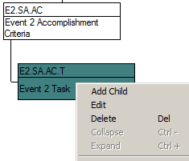
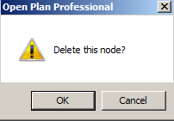
Update – Delete Existing Code Element
Open the code file in exclusive mode
Using the Code View, right mouse click on the code to be deleted and select Delete, or select the Edit ribbon, ‘X’ Delete Code
A box will open asking ‘Delete this node?’, click OK

Slide 51
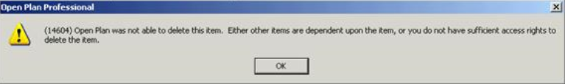


Update – Delete Existing Code Element
Note: The following message will be received if the code selected to be deleted is assigned to OPP activities.
Open a spreadsheet view and remove the code assignments from the activities.
You can now successfully delete the code from the code file

Slide 52

Update – Revise Existing Code Element
Open the code file in exclusive mode
Using the Code View, Double click on the code, or right click and select Edit, or select the Edit ribbon, Details to open the Code Details box
Enter the desired updates to Code and/or Description
Click Apply or Close to add the code to the code file
Save the code file (File>Save)

Slide 53

Update – Revise Existing Code Element
Note: The original code assignment on tasks will be automatically replaced with the revised code.

Slide 54
Remove Code File from an OPP Project
Open the OPP project in exclusive mode
From the Processes ribbon, select Properties in the Dialogs section
Select the Files tab inside of the Project Properties window
Click on the Code Files ellipsis to access the Assign Code box

Slide 55


Remove Code File from an OPP Project
The Assign Code box opens
Highlight the Code to be removed in the Code field to assign code file to panel
Click the Remove button located in the center of the Assign Code box
If codes have been assigned to the activities, the following message will be received:
Click Yes to proceed with removing the code file and code file assignments
Notes:
Note: Recommend always making the prompt start with Cxx then you can add a description if necessary. By using a prompt with the Cxx first, this makes all codes easier to location when trying to add to a view.

Slide 56
Remove Code File from an OPP Project
The code file has been removed from the project
Click OK
Save the OPP Project (File>Save)
Notes:
Note: Recommend always making the prompt start with Cxx then you can add a description if necessary. By using a prompt with the Cxx first, this makes all codes easier to location when trying to add to a view.

Slide 57


Delete Code File from OPP Library
Click on File>Manage Files>Delete
The Select File to Delete box opens
Select Code in the File Type drop down
Highlight the code file to be deleted
Select OK
The following message will appear
Click Yes to delete the code file
Notes:
Note: Recommend always making the prompt start with Cxx then you can add a description if necessary. By using a prompt with the Cxx first, this makes all codes easier to location when trying to add to a view.

Slide 58


Delete Code File from OPP Library
Note: If the code file to be deleted is still attached to an OPP project, the following message will appear:
Select OK, and then remove the code file from the OPP project(s)
If it’s unknown which OPP project(s) the code file is attached to, highlight the code file in the OPP Library and from the OPP menu select Project Properties, and select the References tab to display a list of projects with the code file attached.
Notes:
Note: Recommend always making the prompt start with Cxx then you can add a description if necessary. By using a prompt with the Cxx first, this makes all codes easier to location when trying to add to a view.

Slide 59

Print the Contents of a Code File
Open the OPP project in either ‘exclusive’ or ‘read only’ mode
Open any spreadsheet view (i.e., SPREADVW)
Right click anywhere in the view and select Preferences or in the View ribbon, select Preferences
Notes:
Note: Recommend always making the prompt start with Cxx then you can add a description if necessary. By using a prompt with the Cxx first, this makes all codes easier to location when trying to add to a view.

Slide 60

Print the Contents of a Code File
Select the desired code file from the Table Name drop down list on the Options tab
Click OK to display the contents of the code file
Notes:
Note: Recommend always making the prompt start with Cxx then you can add a description if necessary. By using a prompt with the Cxx first, this makes all codes easier to location when trying to add to a view.

Slide 61


Print the Contents of a Code File
Contents of the Code file are now displayed
Select File>Print
Notes:
Note: Recommend always making the prompt start with Cxx then you can add a description if necessary. By using a prompt with the Cxx first, this makes all codes easier to location when trying to add to a view.

Slide 62


Print the Contents of a Code File
Print Setup can be selected to define printer, paper, and orientation options.
Print Options can be selected to define margins, orientation, and other options.
Notes:
Note: Recommend always making the prompt start with Cxx then you can add a description if necessary. By using a prompt with the Cxx first, this makes all codes easier to location when trying to add to a view.

Slide 63
CHANGE LOG
DATE | SLIDE | DESCRIPTION OF CHANGE
10/11/16 | Most | Updated slides to reflect OPP 8.0

